Slide 1

Coarse-Grained RNA Model for the Martini 3 Force Field

Slide 2
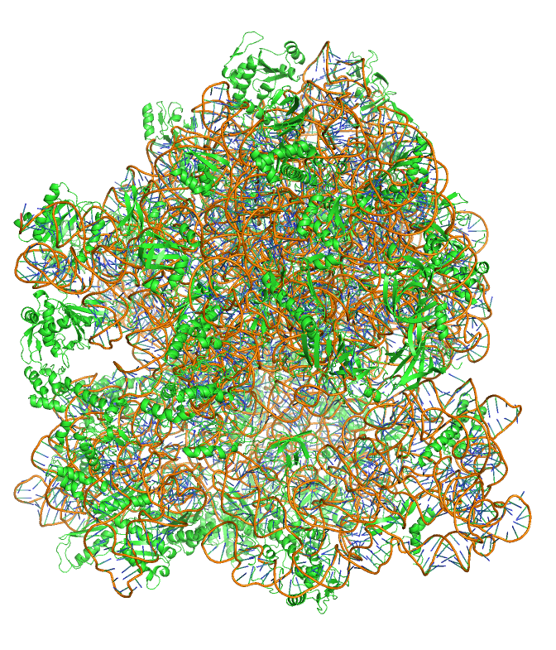
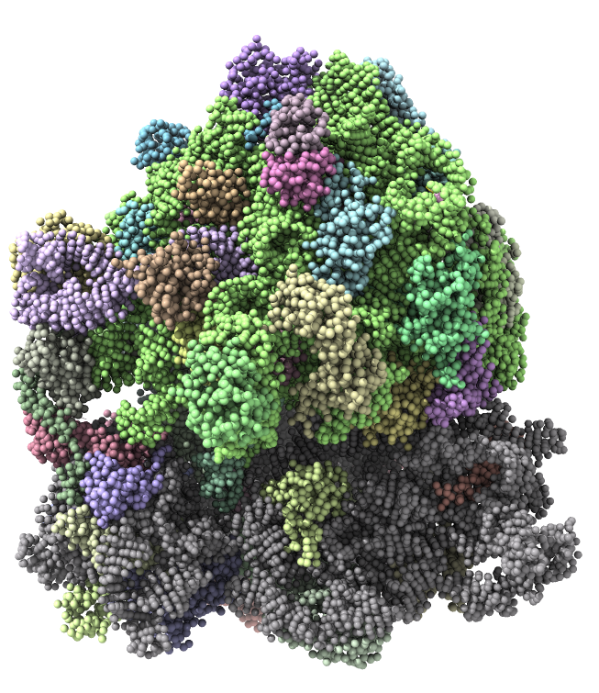
How to simulate a ribosome in a lifetime of a PhD student?
~ 2 million particles
~ 150 thousand particles

Slide 3
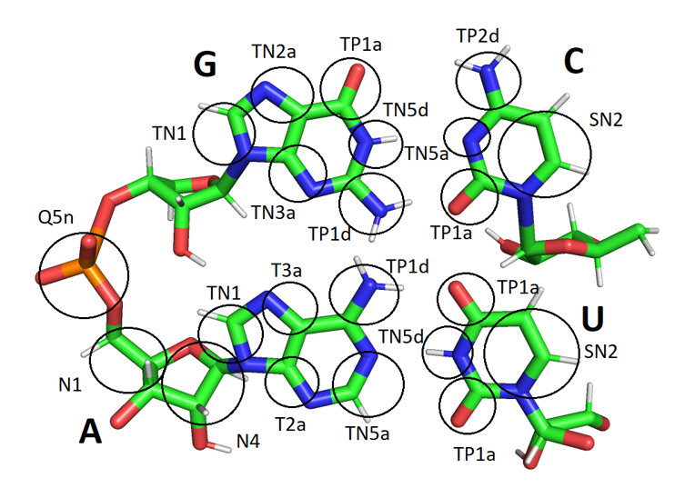
Mapping scheme for the RNA model

Slide 4
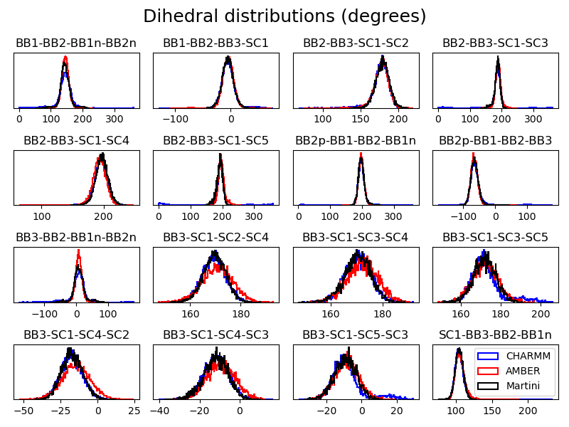
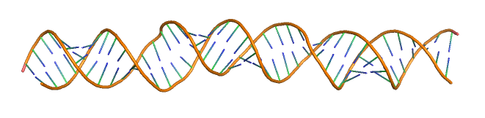
Fitting of the bonded parameters

Slide 5
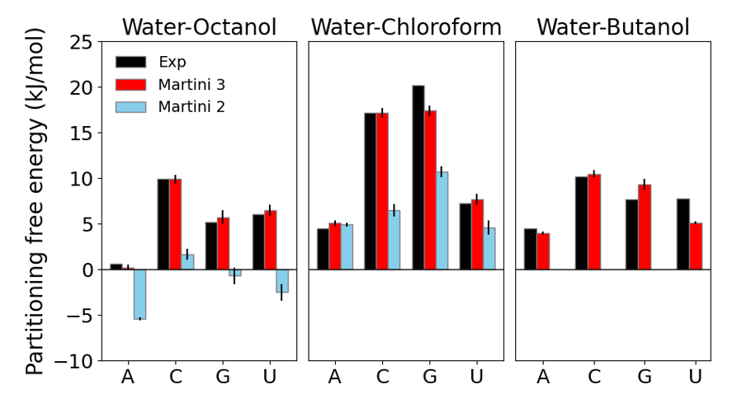
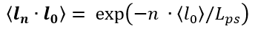
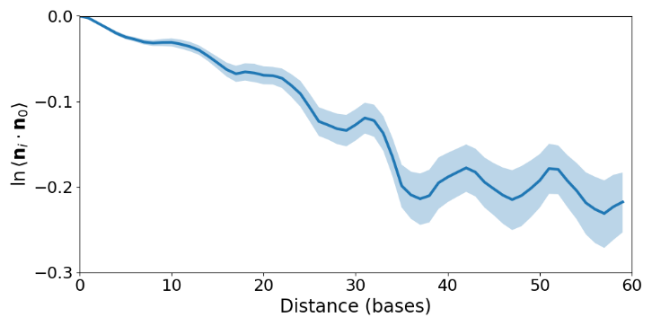
Comparisons with some experimental data
Transfer free energies of RNA nucleobases
Persistence length of dsRNA
Model = 72 nm
Experiment = 64 nm.

Slide 6
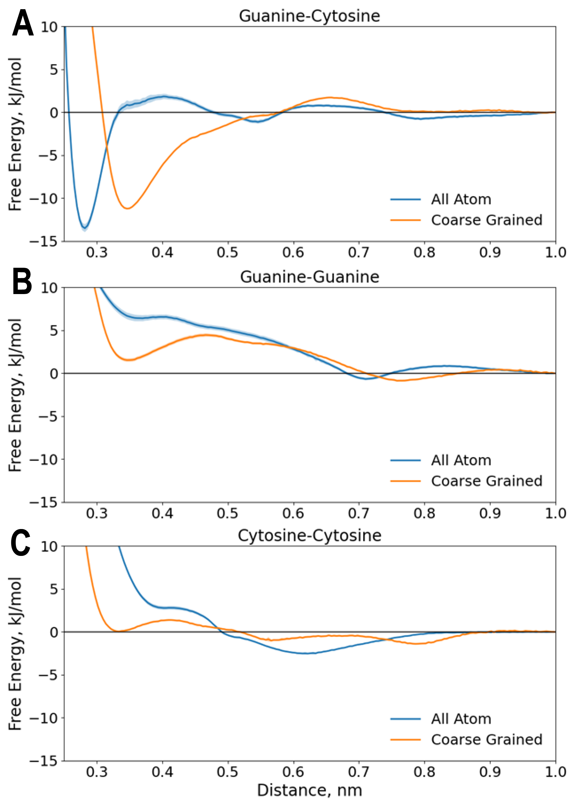
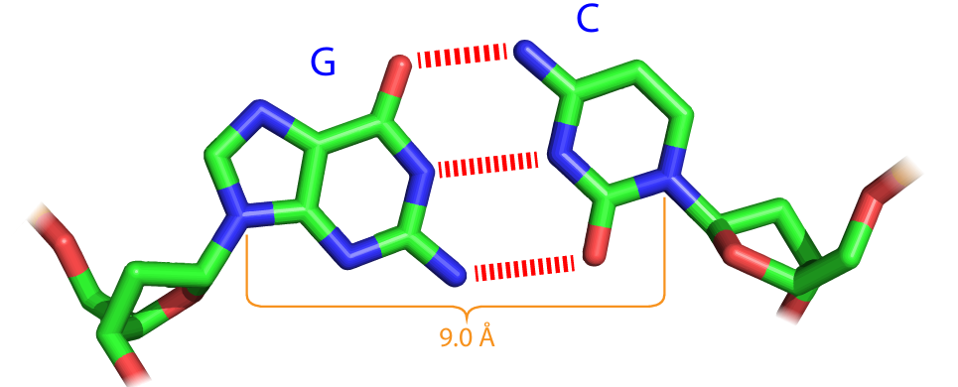
Hydrogen bonding PMF profiles

Slide 7
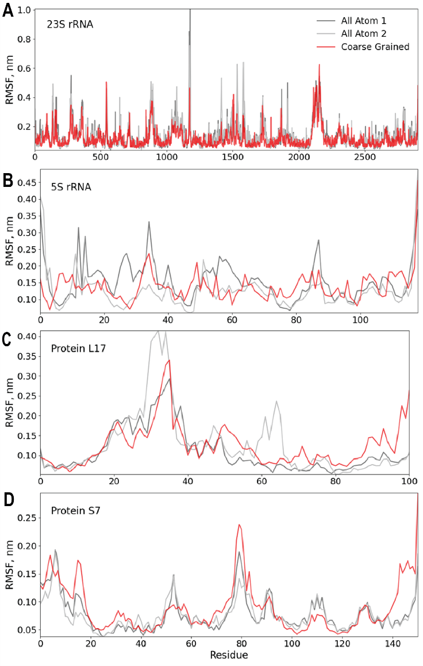
So what about the ribosomes

Slide 8
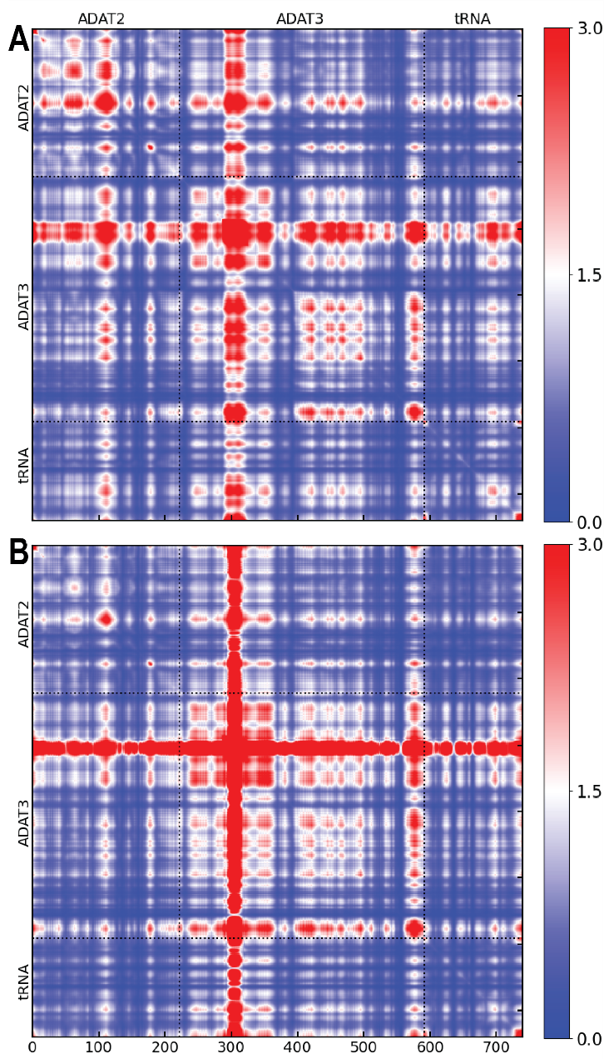
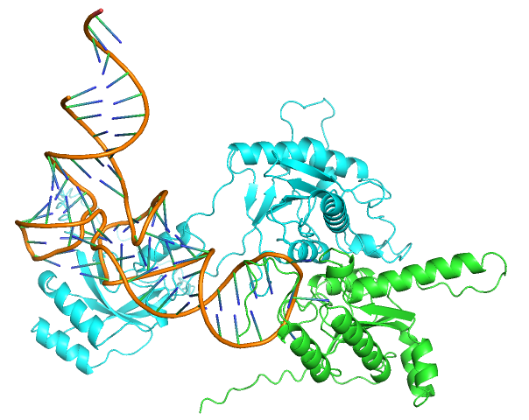
Correlation analysis of ADAT2/3 deaminase
Martini
ENM

Slide 9
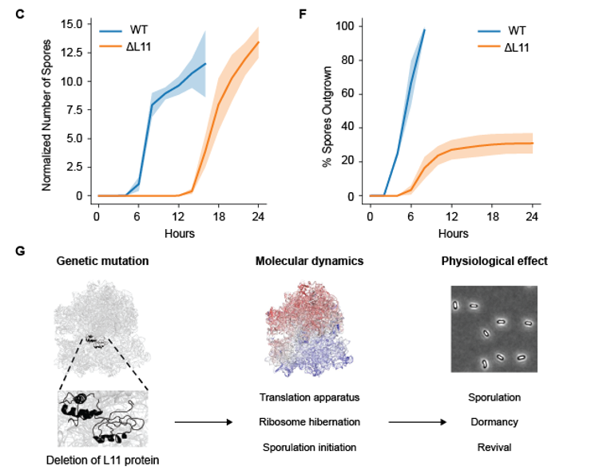
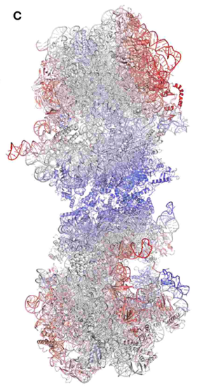
ΔL11 is delayed in sporulation and impaired in spore revival

Slide 10
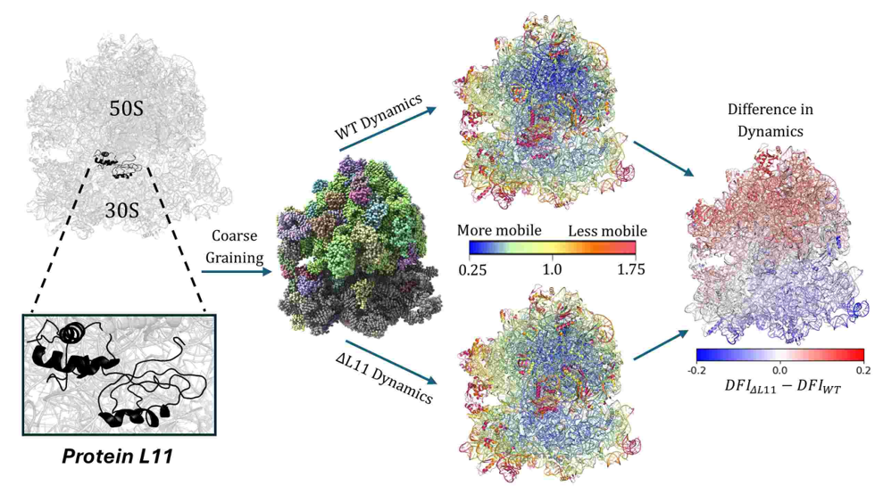
Workflow

Slide 11
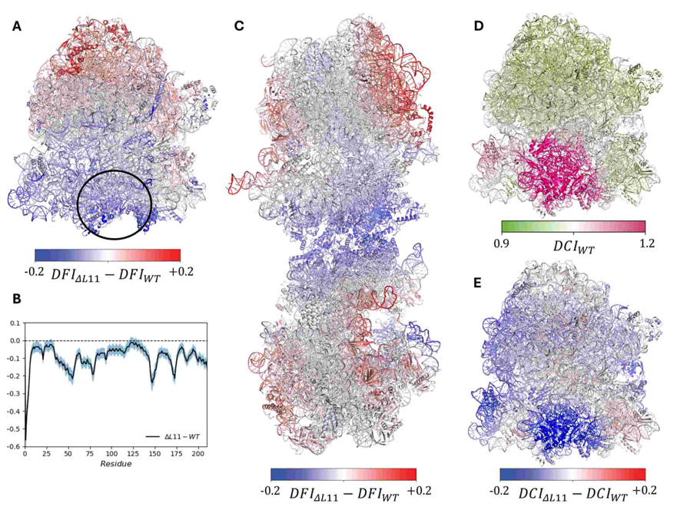
Rigidification of small subunit – link to spore revival

Slide 12
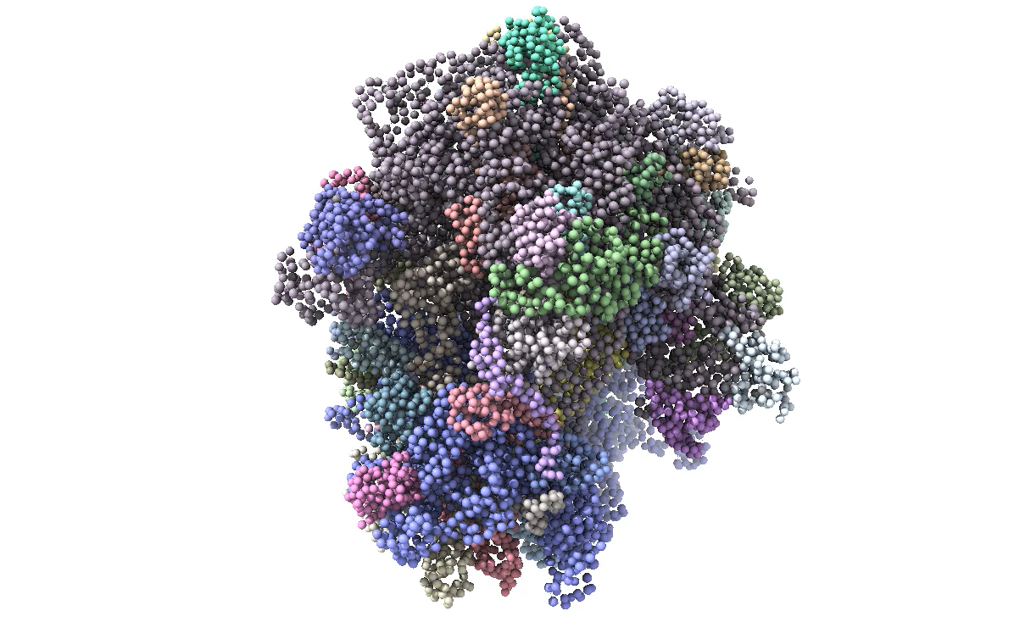
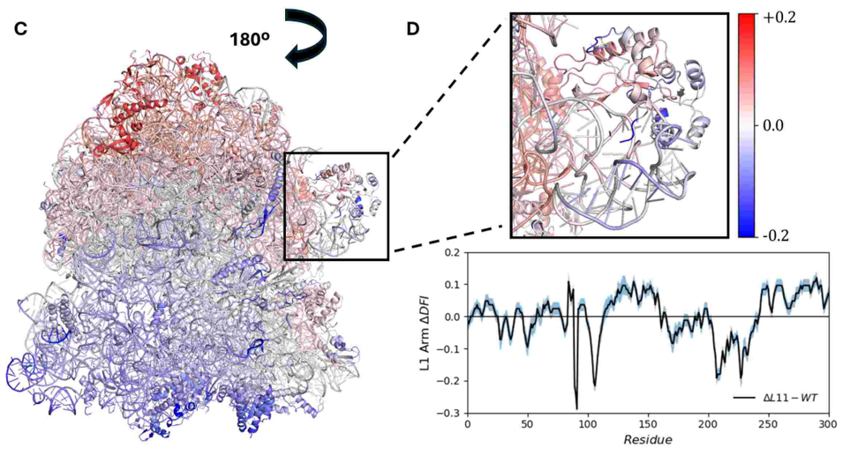
L11 deletion affects the dynamics of translation apparatus – L1 arm
L1 arm
L10/11 arm

